Slide 1


Introduction to Machine Learning
Machine learning is a subfield of artificial intelligence that focuses on the development of algorithms and models that enable computers to learn and make predictions or decisions without being explicitly programmed. It encompasses a wide range of techniques and approaches, including supervised learning, unsupervised learning, reinforcement learning, and more. Understanding the fundamentals of machine learning is crucial in today's technology-driven world, as it forms the backbone of many innovative applications and solutions.

Slide 2
"machine learning is a field of study that give computers the ability to learn without being explicitly programmed" -arthur samuel 1959

Slide 3
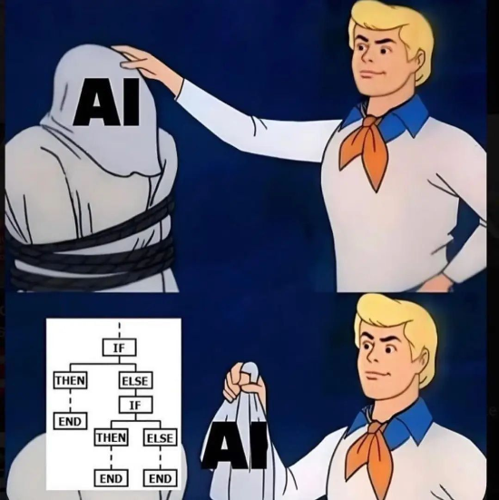
Traditional Programming vs Machine Learning
In traditional programming, the programmer writes explicit rules and instructions for the computer to follow. With machine learning, the computer learns to recognize patterns and make decisions on its own. While traditional programming is good for tasks with clear rules, machine learning is better suited for tasks with complex patterns or large amounts of data.

Slide 4
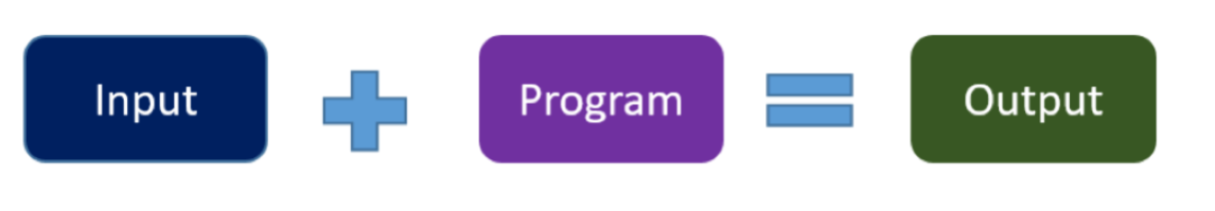
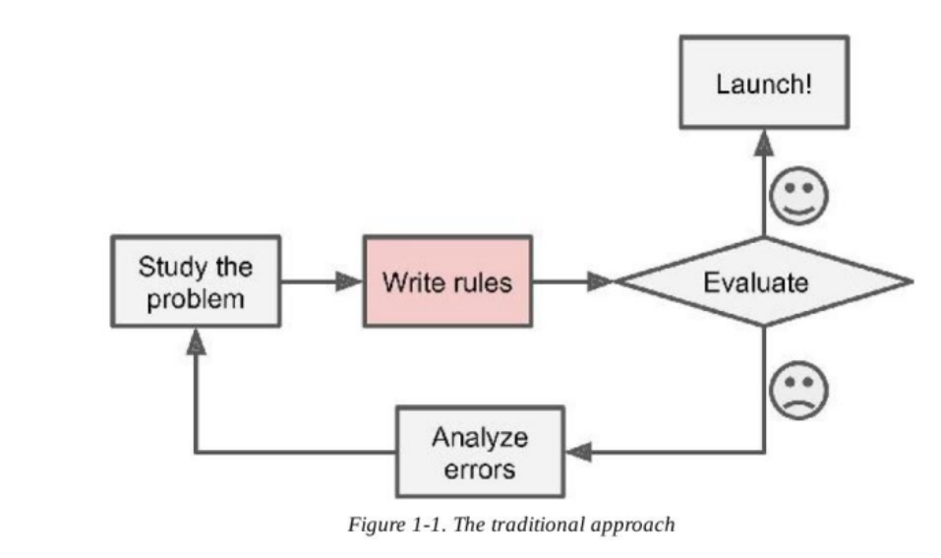
Traditional approach :

Slide 5
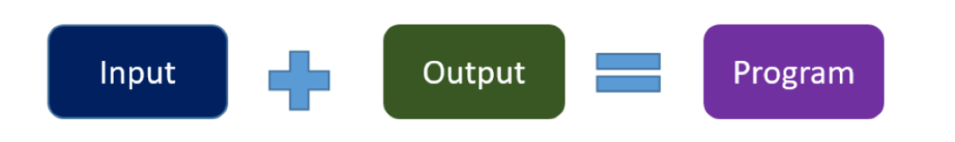
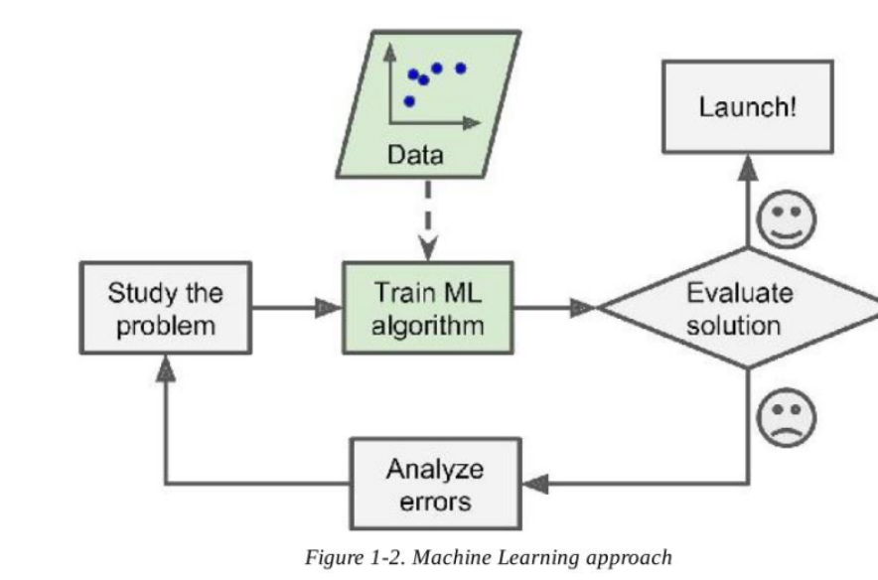
Machine learning approach:

Slide 6
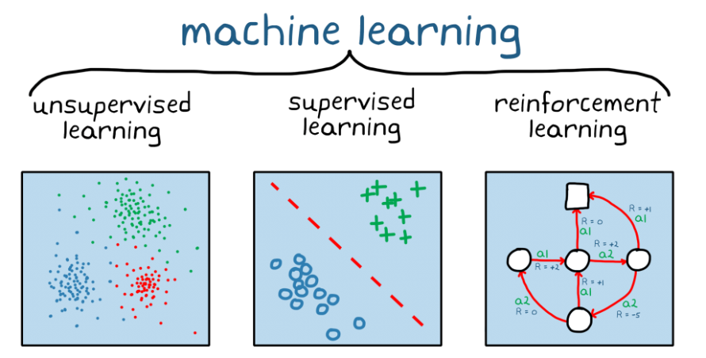
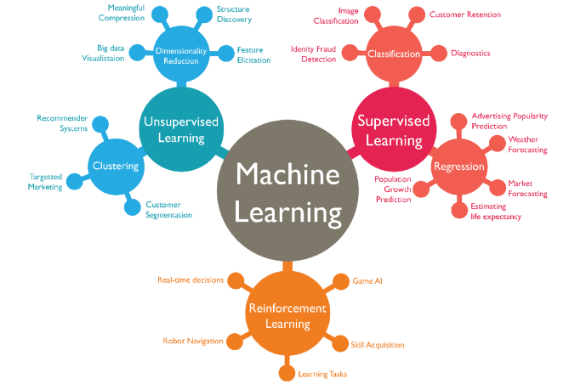
Machine Learning

Slide 7
Supervised Learning
Data Labeling
Regression & Classification
In supervised learning, the algorithm learns from labeled training data, where each input is paired with a corresponding output. This enables the algorithm to make predictions or decisions based on new, unseen data by associating input patterns with target output values.
Supervised learning encompasses regression tasks that involve predicting a continuous output and classification tasks that involve categorizing input data into predefined classes or categories.

Slide 8
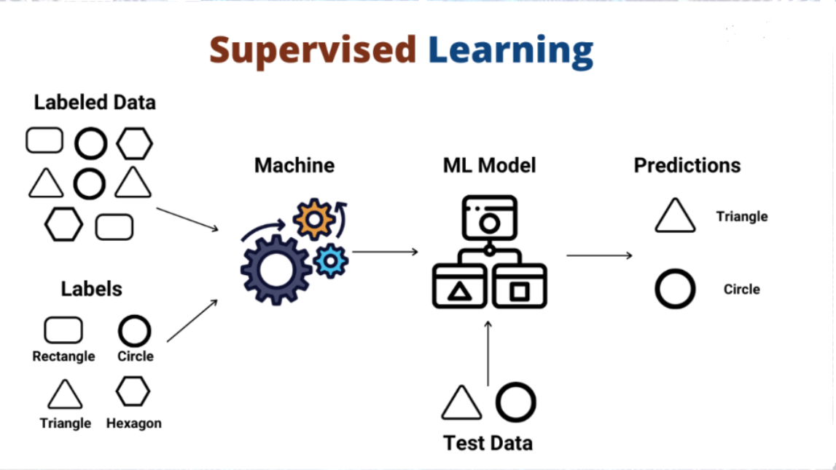

Slide 9

Unsupervised Learning
1
Clustering & Association
2
Anomaly Detection
Unsupervised learning focuses on identifying patterns and structure within input data, including techniques such as clustering to group similar data points and association to discover relationships among variables.
Another key aspect of unsupervised learning is anomaly detection, which aims to identify unusual or abnormal patterns in the data that may require further investigation or action.

Slide 10

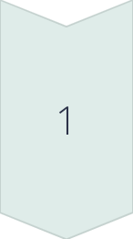

Reinforcement Learning
Agent-Environment Interaction
Reinforcement learning involves an agent interacting with an environment, learning to achieve a goal through the consequence of its actions, and receiving feedback in the form of rewards or penalties.
Exploration & Exploitation
One of the key challenges in reinforcement learning is finding the right balance between exploration (trying new actions to discover potential rewards) and exploitation (leveraging known actions for immediate rewards).

Slide 11

Regression: Logistic, Linear
Linear Regression
Logistic Regression
Linear regression models the relationship between a dependent variable and one or more independent variables by fitting a linear equation to the observed data.
Logistic regression is used for binary classification tasks, where the output is a probability estimate for a particular class.

Slide 12
Cost Function
Minimization
Minimization
The cost function aims to be minimized during the training process to find optimal model parameters that best fit the data.
Optimization Techniques
Optimization Techniques
Various techniques such as gradient descent are used to iteratively minimize the cost function and update model parameters.
—

Slide 13
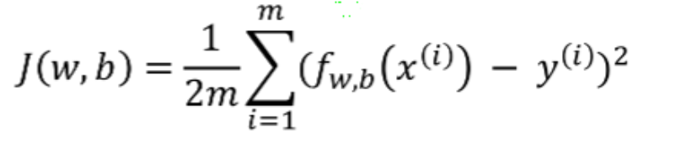
cost function

Slide 14

Gradient Descent
1
Initialization
Gradient descent starts with the initialization of model parameters or weights with certain values.
2
Update
During each iteration, the model parameters are updated in the direction that minimizes the cost function, guided by the gradient of the function with respect to the parameters.
3
Convergence
Gradient descent continues the update process until it converges to the minimum value or a predefined stopping criterion is met.

Slide 15
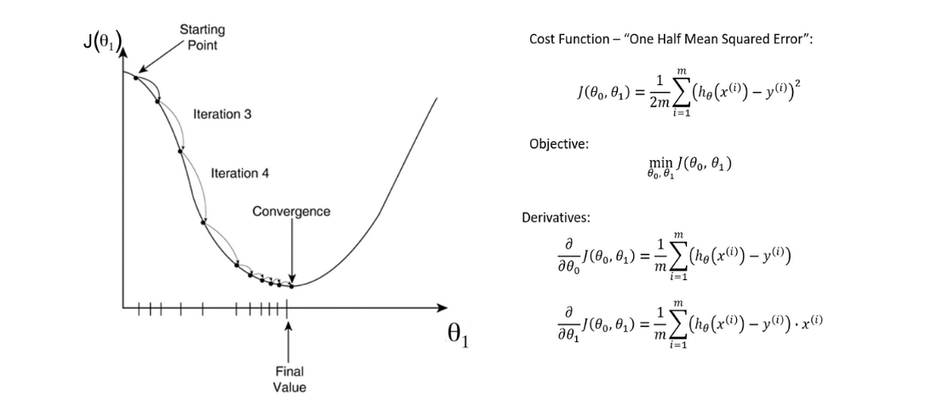
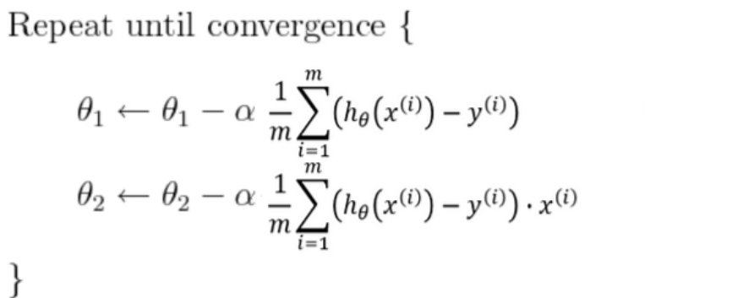
Example : linear regression

Slide 16
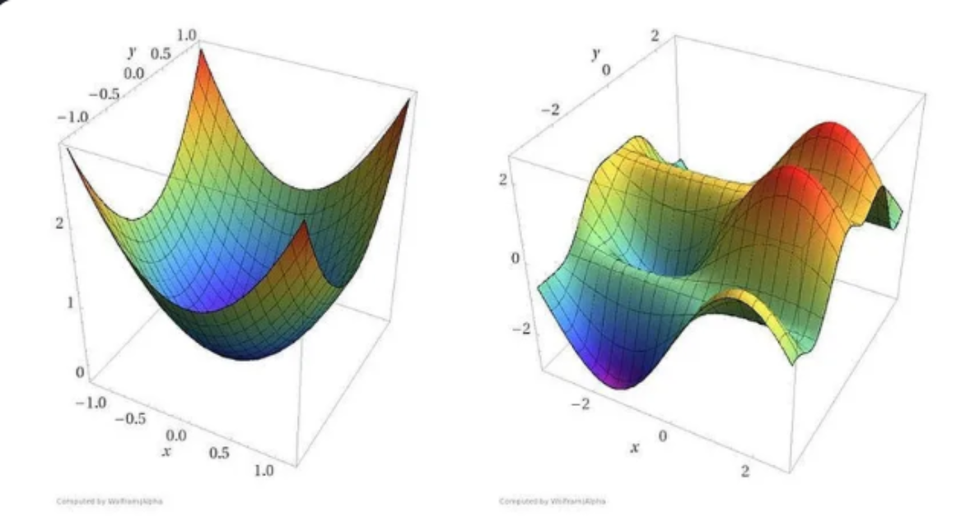

Slide 17

Gradient Descent Example: Linear Regression
In linear regression, gradient descent is used to minimize the cost function and find the optimal values for the regression coefficients. By iteratively adjusting the coefficients based on the gradient of the cost function, the algorithm converges to the best fit line that minimizes the error between the predicted and actual values.

Slide 18
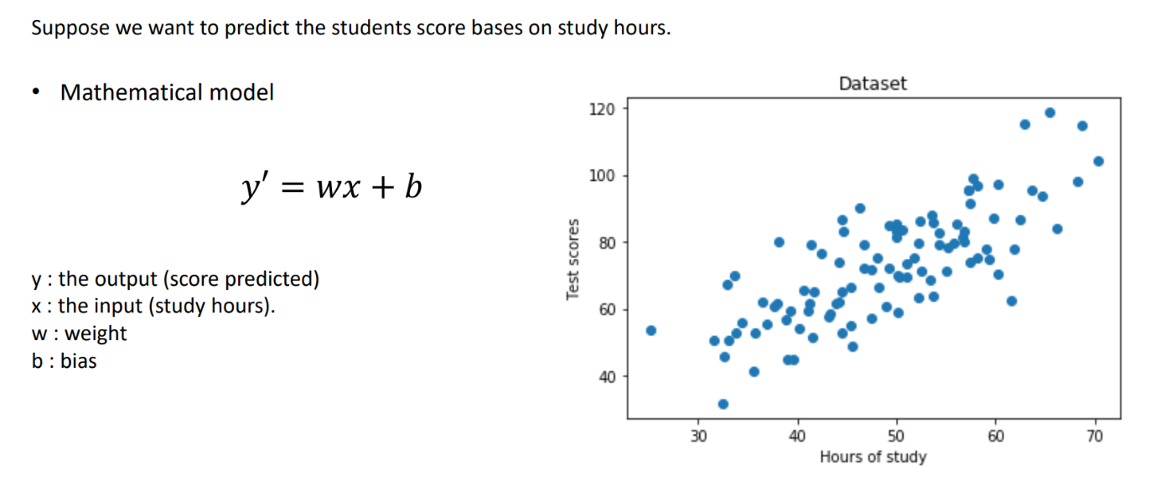
Example : linear regression

Slide 19
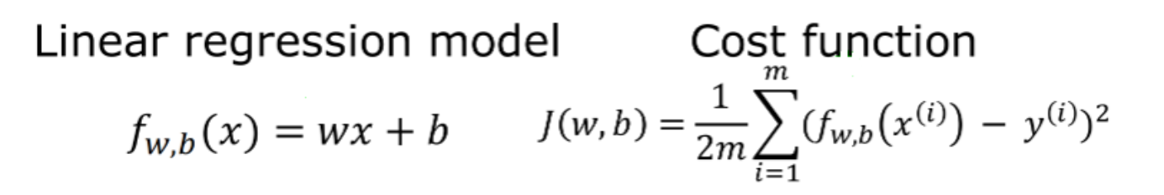
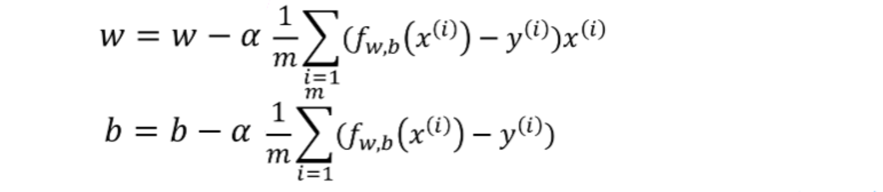
Example : linear regression

Slide 20
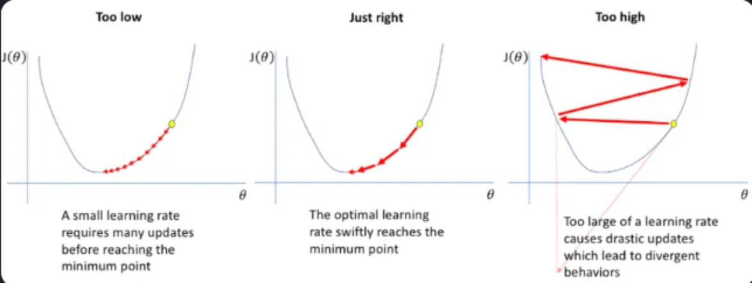
Example : linear regression
Learning rate α : is a hyperparameter that controls how much to change the model in response to the estimated error each time the model weights are updated.

Slide 21
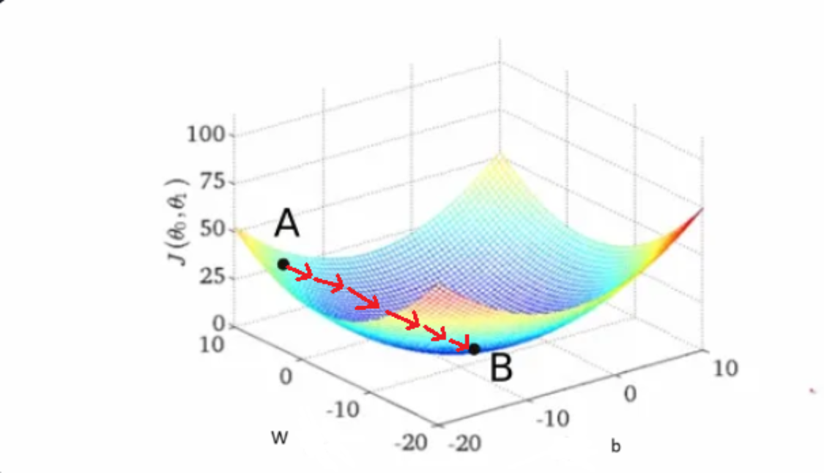
Example : linear regression

Slide 22

Example : linear regression

Slide 23
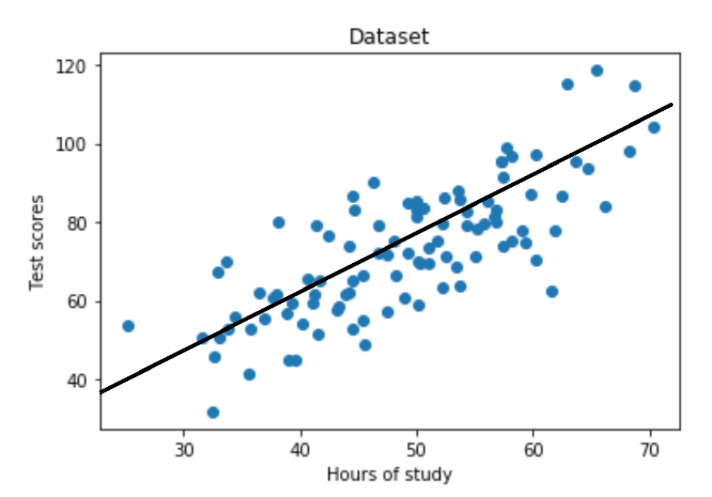
Example : linear regression

Slide 24
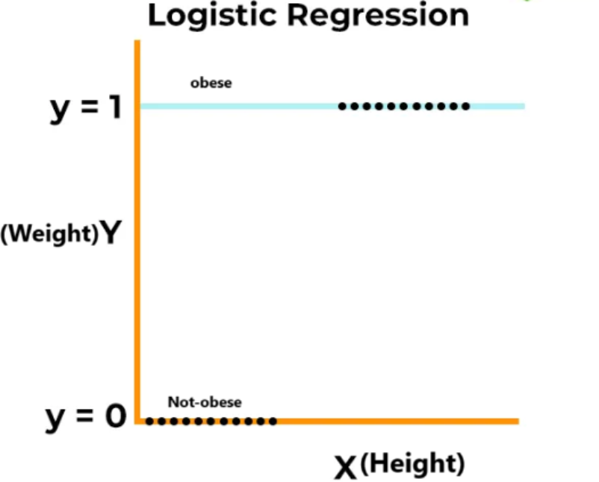
Example : logistic regression

Slide 25
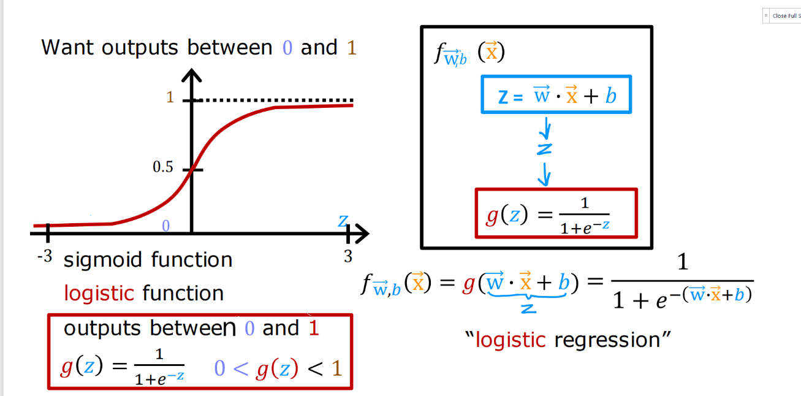
Example : logistic regression
Sigmoid Function (logistic function) :

Slide 26
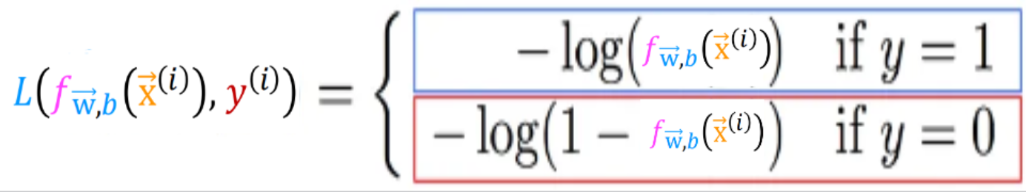
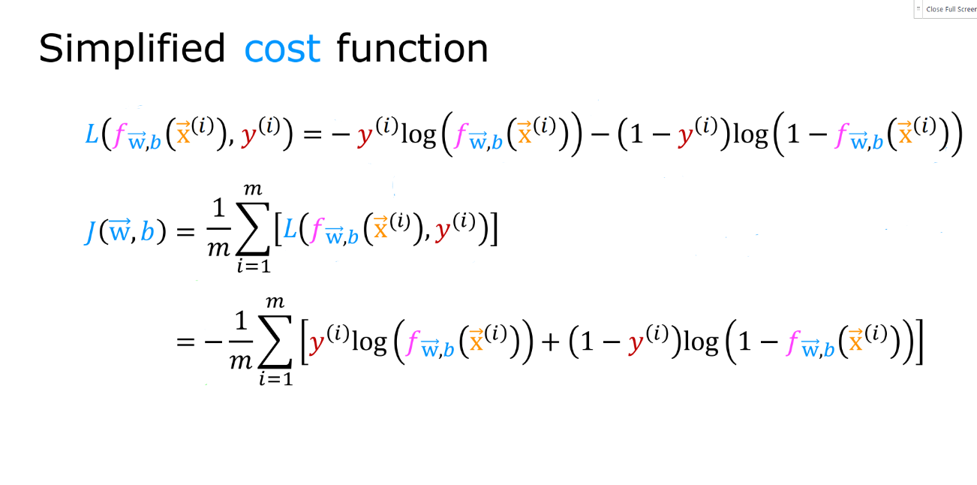
Example : logistic regression

Slide 27
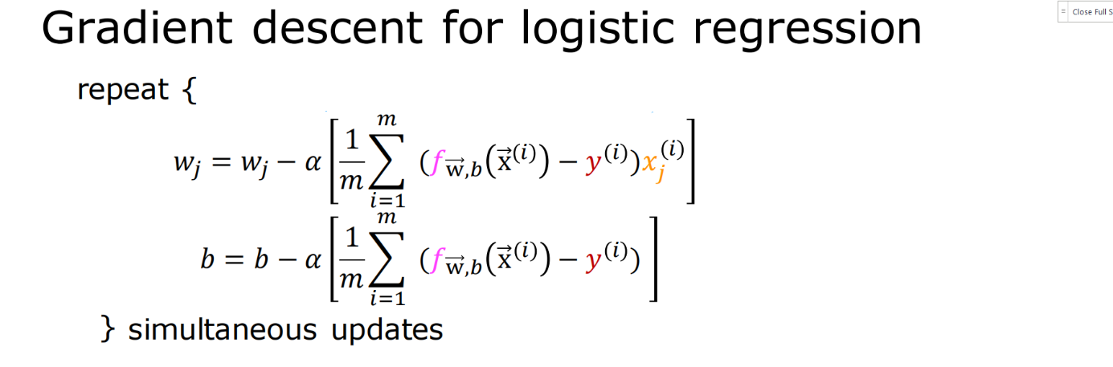
Example : logistic regression

Slide 28
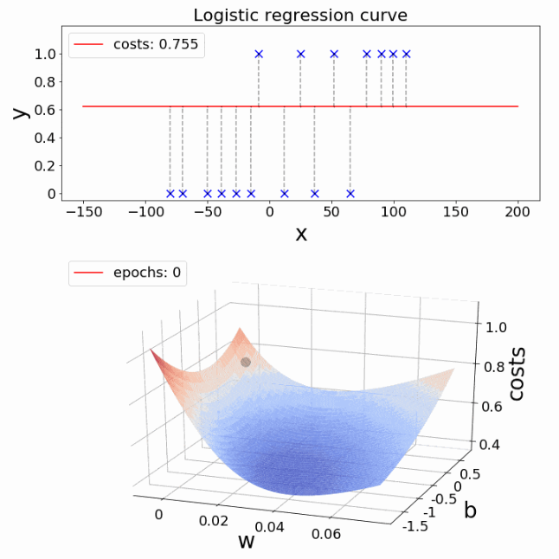
Example : logistic regression

Slide 29
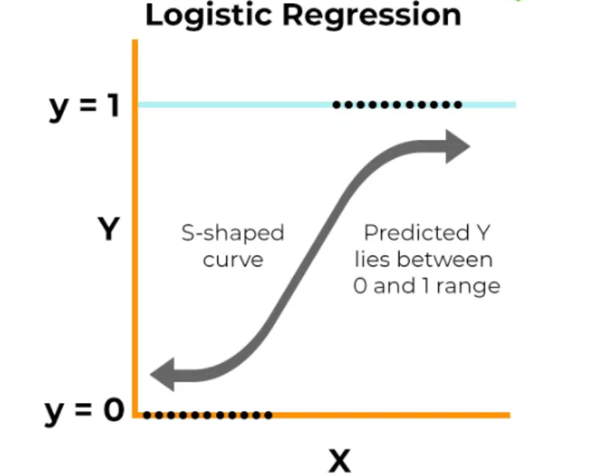
Example : logistic regression

Slide 30
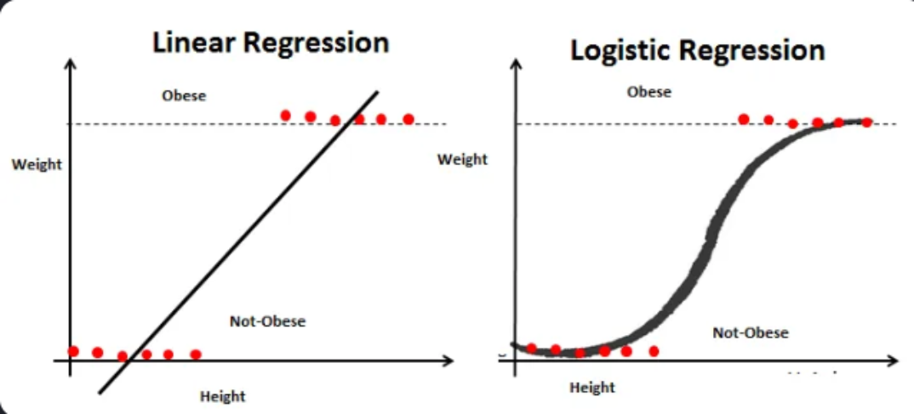
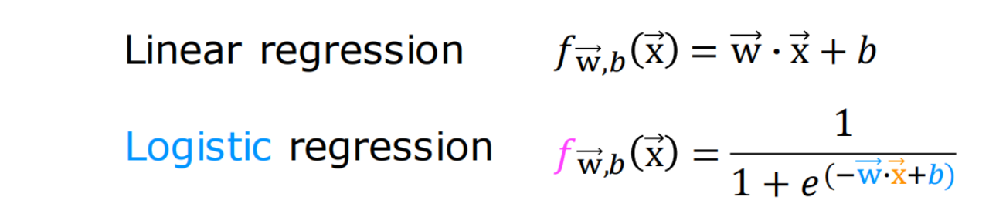
logistic regression vs linear regression

